Slide 1
Play Database
The plan
Problem: Toy and Game inventors, designers, creatives etc… are not recognized for the products they create.

Slide 2
Ideate: Frame your Design
Design Question How might we recognize toy and game inventors? | Impact Improve our event goers awareness of the toy and game inventors that make the playthings they love. | Solutions PlayDB Fair signage Inventor is credited on toy/game package | Constraints Will they sign up? Working with big companies Signs cost money

Slide 3
Personas
Conference goer
Gala goer
Fair goer

Slide 4
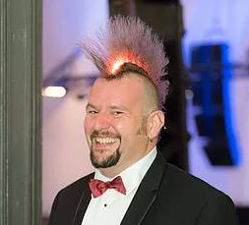



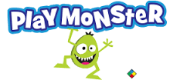
Thomas Bahamas
Bio
Tom is a toy inventor who has been in the industry for 5 years. He joined the Professional Inventor Track and joined in on TAGIEs with many of his peers. Tom specializes in toys for visually impaired children. Tom is a good guy.
Goals
Network with inventors
Celebrate his peers achievements
Learn about the greats in his industry
Frustrations
Spent a lot of money and time to be here
His latest toy idea isn’t taking off like he thought it wold
“I want to learn about and connect with the TAGIEs nominees and winners.”
Brands
Age
Occupation
Location
35
Toy Inventor
Chicago
Motivations
Money
Make great toys for the visually impaired children

Slide 5
Gala goer user stories
Find TAGIEs nominee
As a… Gala goer
I want to… look up a TAGIEs award winner
So that… Learn about an esteemed member of my community
Find TAGIEs attender
As a… Gala goer
I want to… network with my TAGIEs attender
So that… Ask advice, collaborate on projects, Find companies to pitch too... etc.

Slide 6
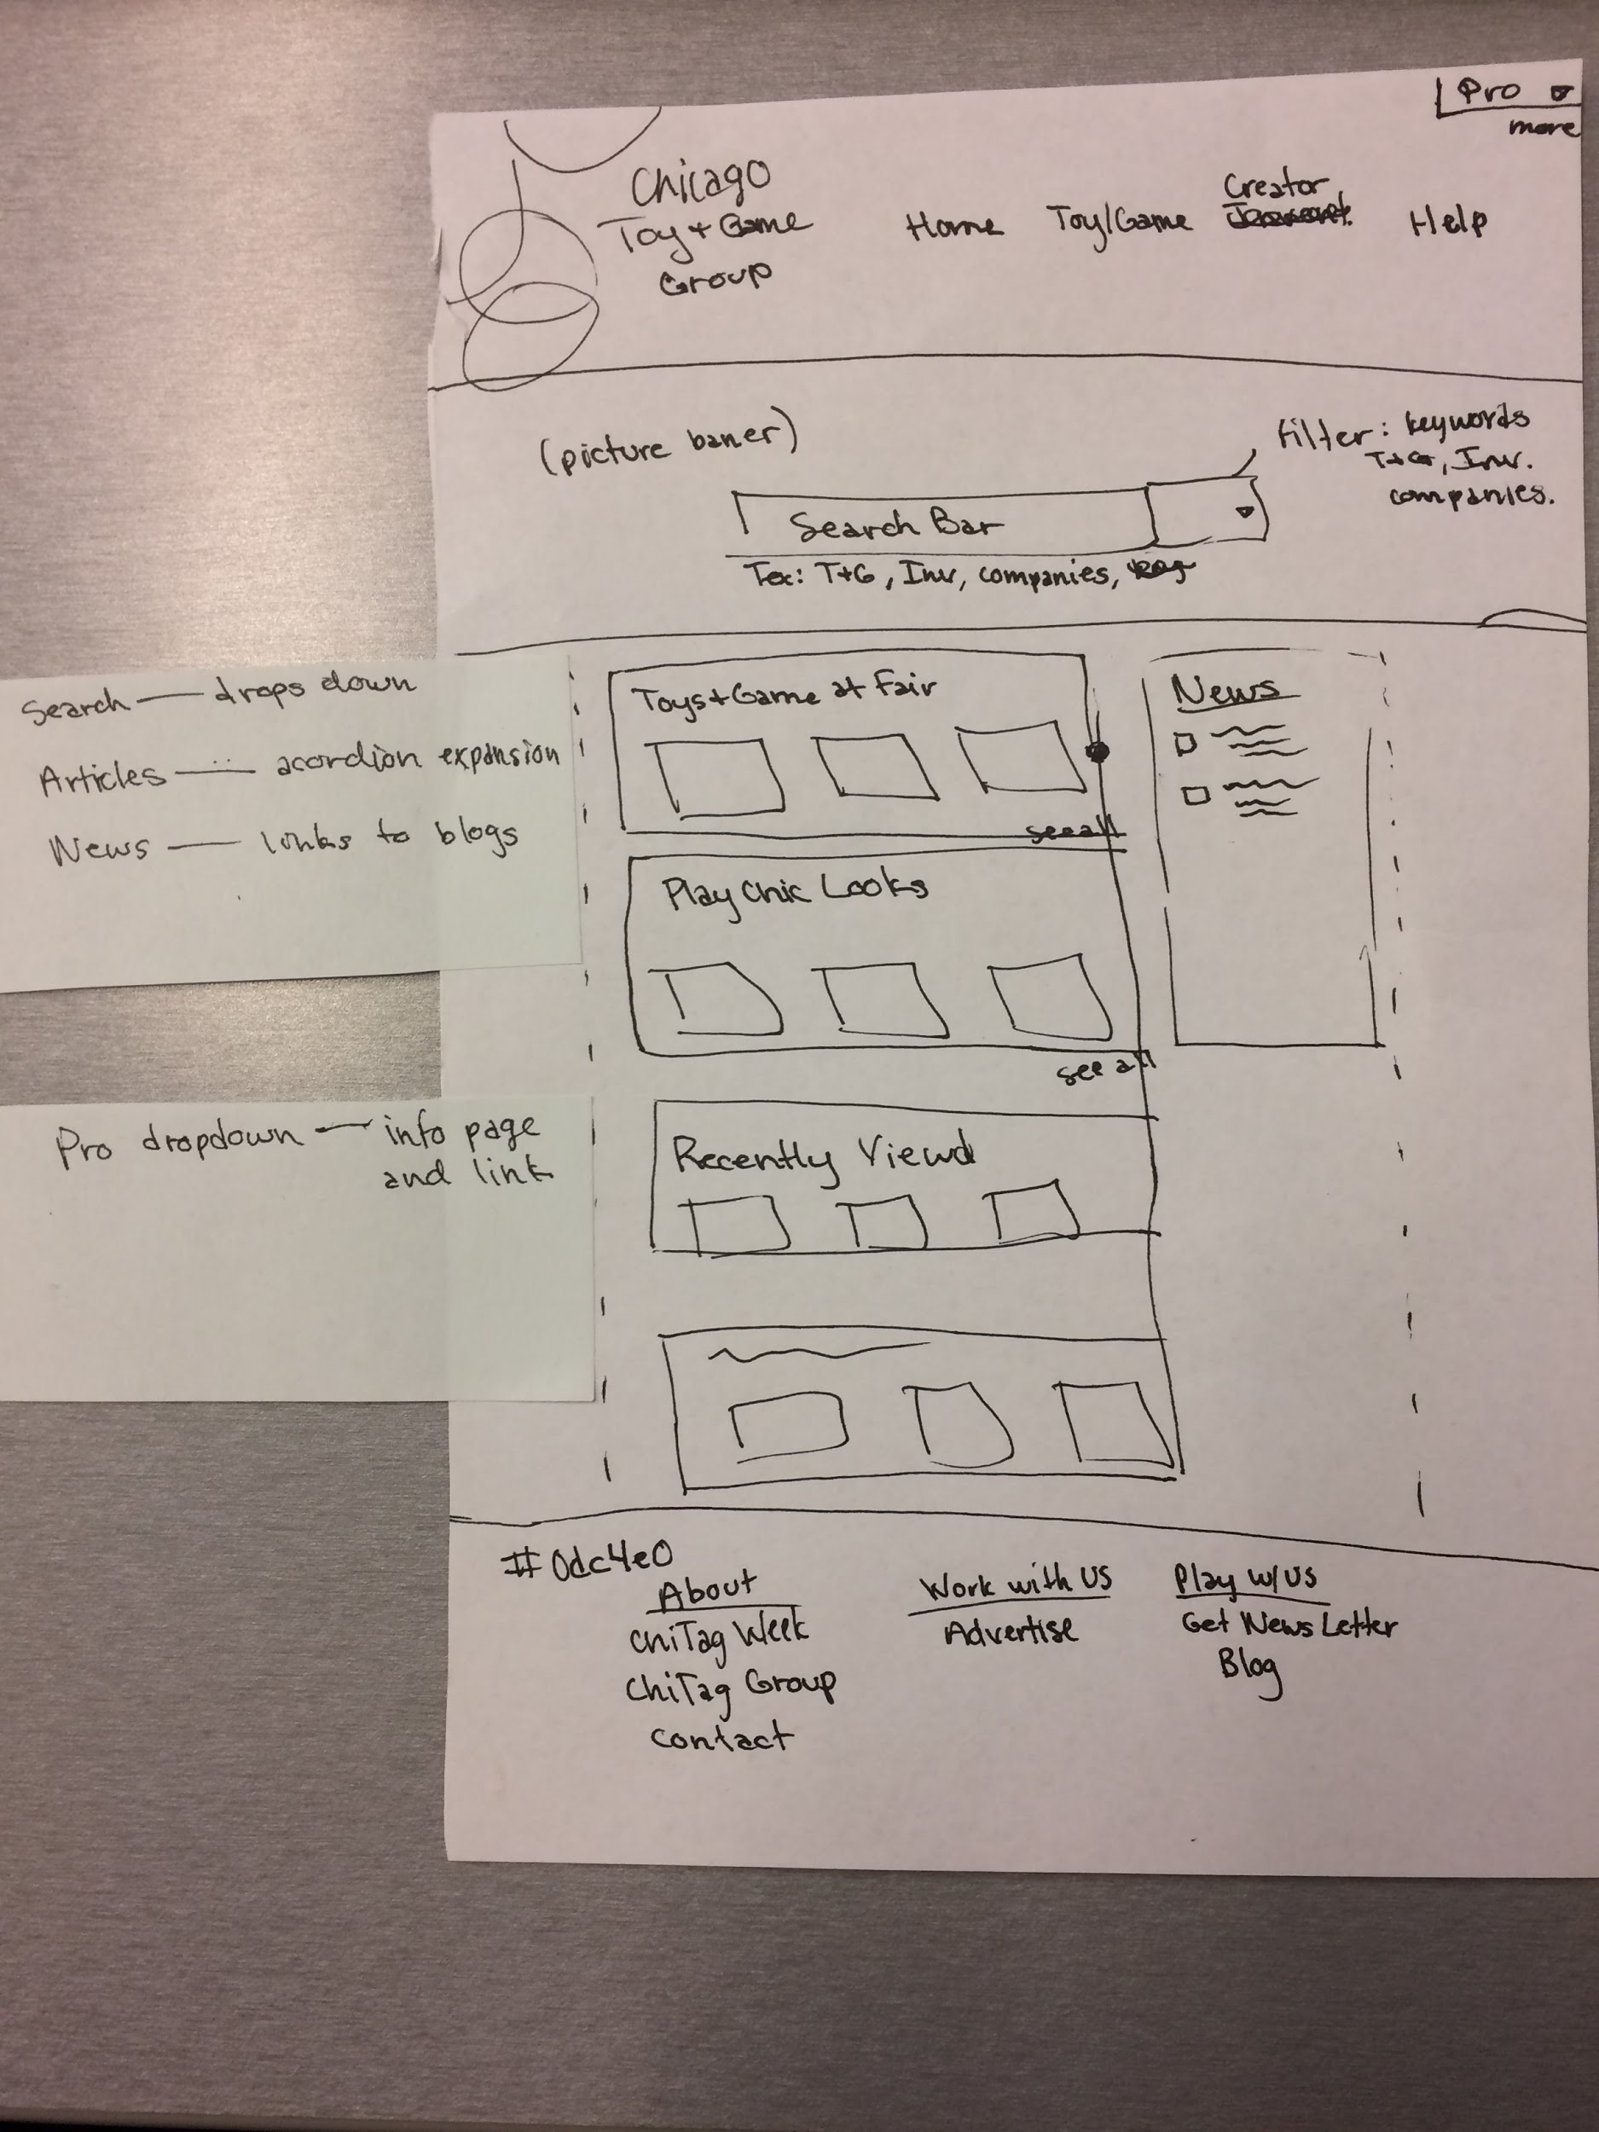
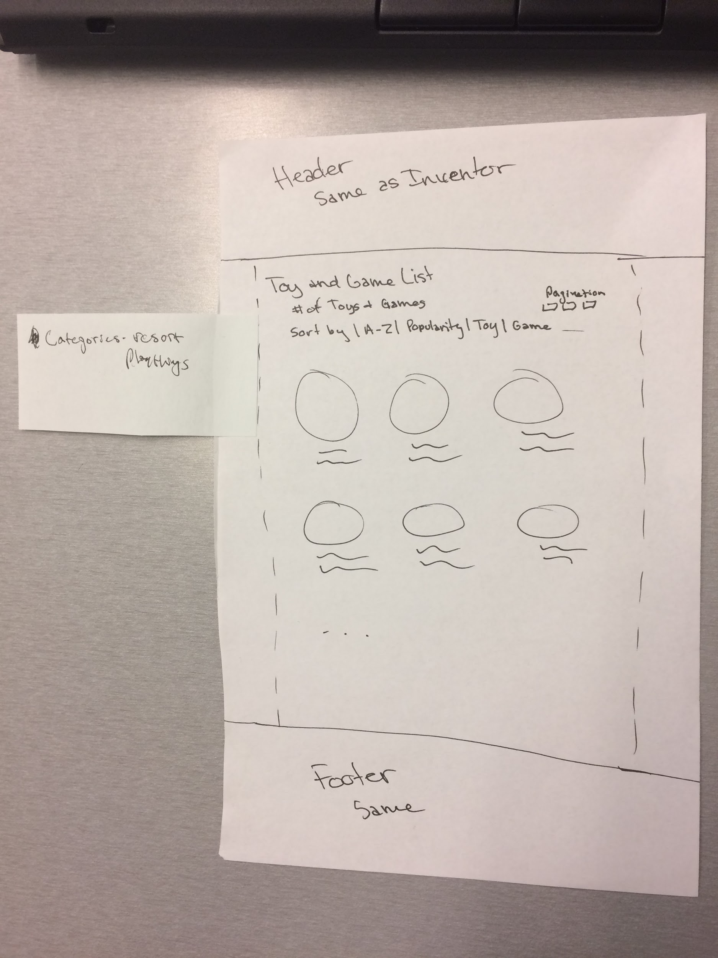
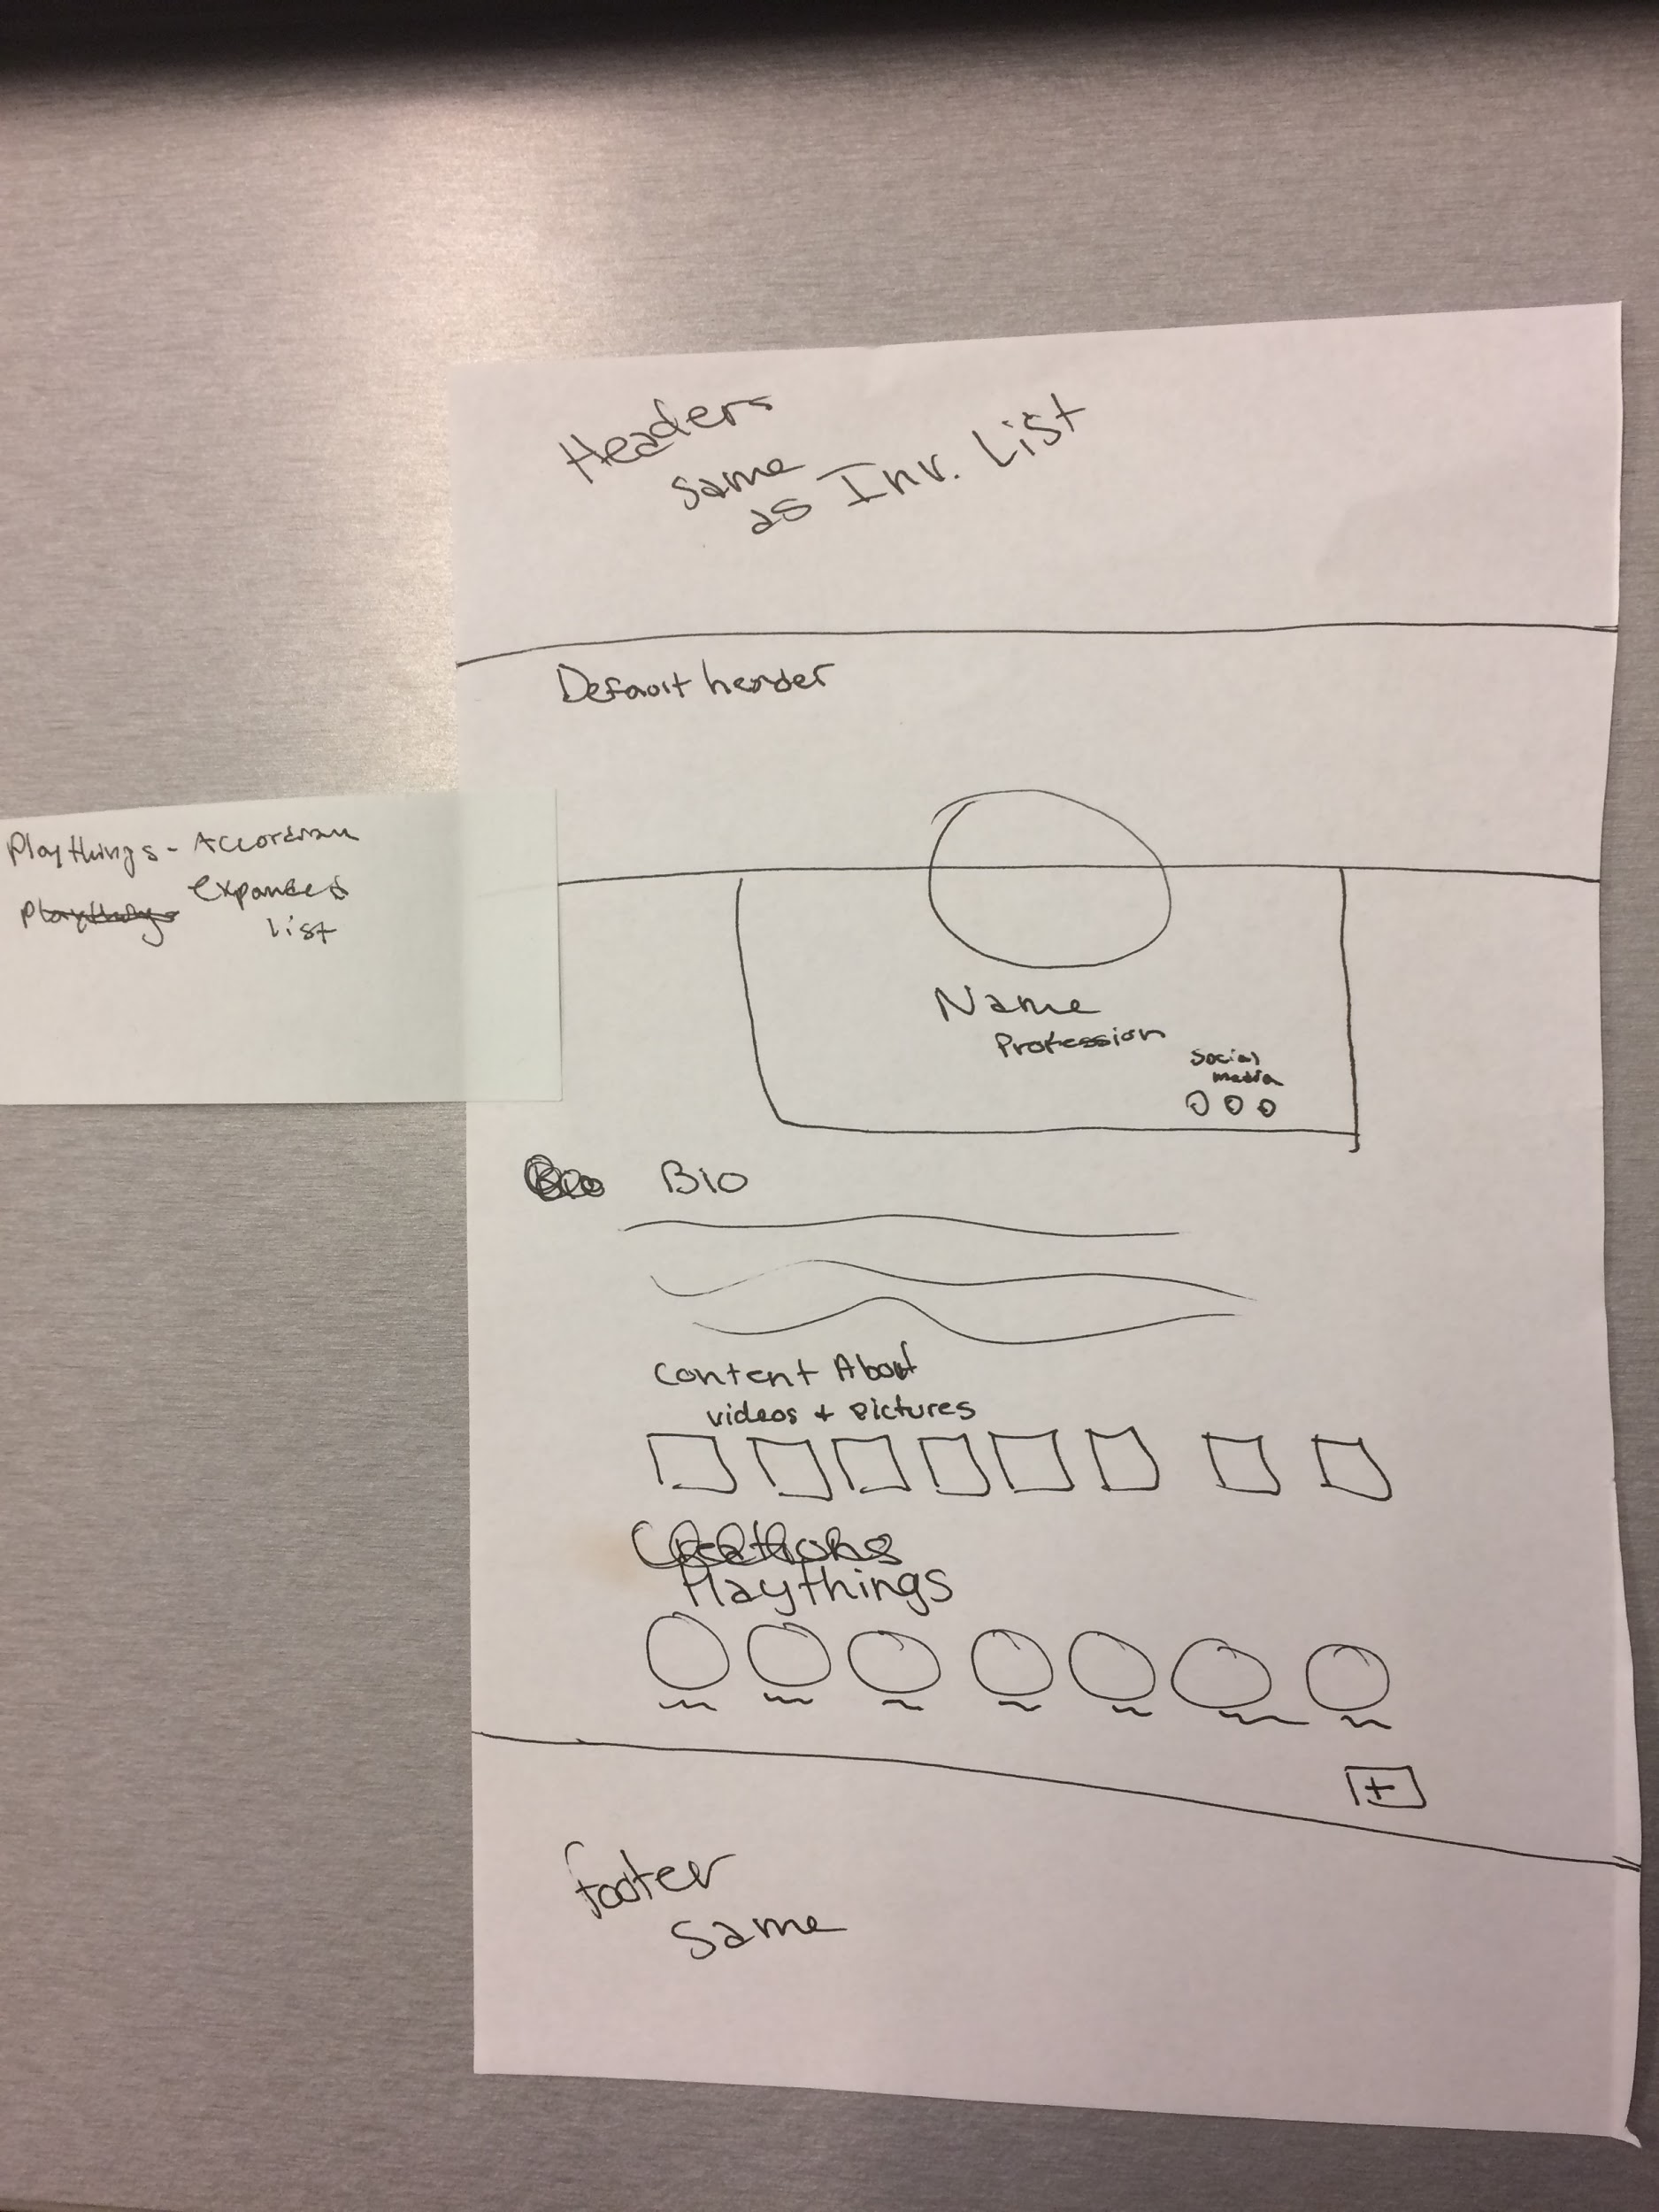
Wireframing

